Slide 1
Sobel Edge Detection vs. Canny Edge Detection
by Bekenova Aruzhan Buranovna

Slide 2
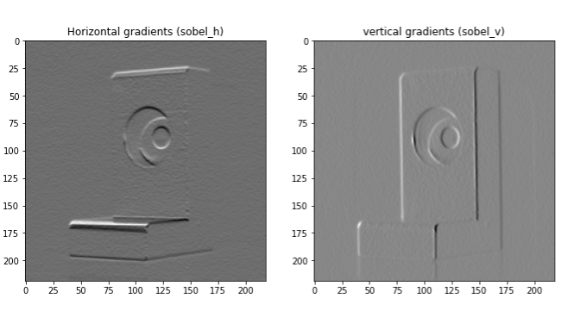
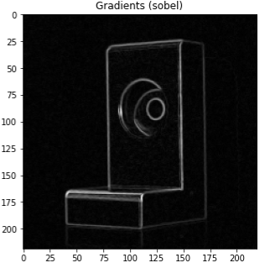
The Sobel operator is used to detect edges in an image by calculating brightness gradients in the horizontal (Gx) and vertical (Gy) directions. To do this, two filters (masks) are used, each of which highlights the brightness changes in the appropriate direction. After obtaining these two gradients, they are combined to get a final gradient image that highlights the edges in the image.

Slide 3
In this example, the Sobel Edge detection algorithm was implemented in Simulink. The algorithm consists of two 2D filters, one to calculate the gradient in the column direction (the best filter) and one to calculate the gradient in the row direction (the bottom filter). Both filters use a 3x3 core.

Slide 4
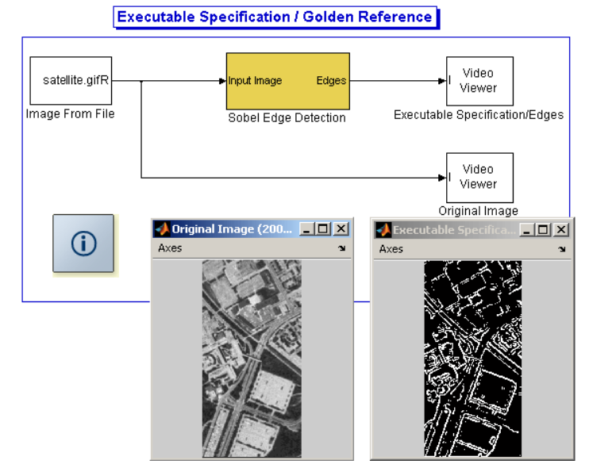

Slide 5
Previous scheme ("Executable Specification / Golden Reference")It represents the basic implementation of the Sobel edge detection algorithm.Main stages:Reading the image.Application of the Sobel filter.Output of two images: the original one and the processed one (with highlighted edges). now I want to provide an optimized version of the algorithm that is close to the actual hardware implementation.

Slide 6
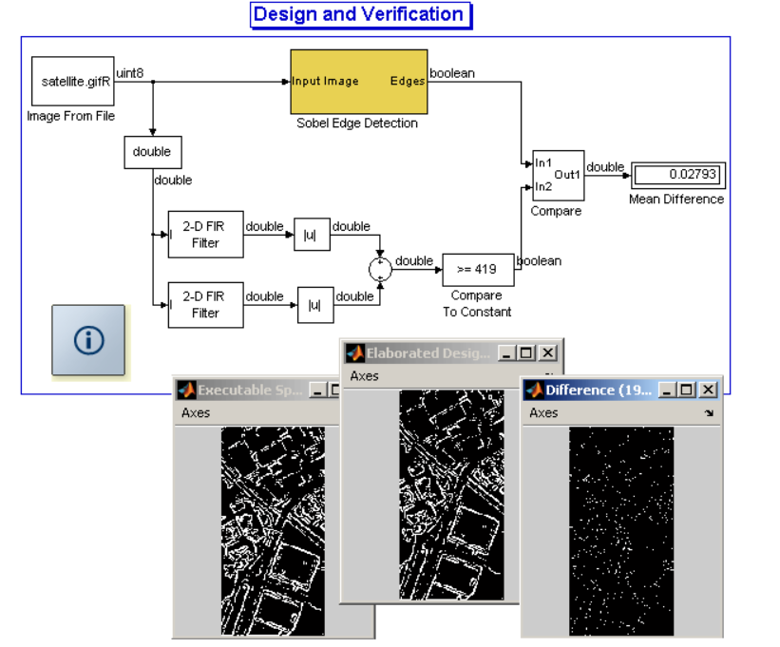

Slide 7
Note that the higher the threshold, the fewer contours are detected (fewer white pixels). This is because fewer pixels have a gradient greater than the threshold and will therefore be considered edges.If the threshold is too low, then edges are found almost everywhere. In particular, since the background of the image is (slightly) noisy, edges can be detected there.On the contrary, if the threshold is too high, there will be many undetected cases, although there will be almost no false positives.In addition, even if you set the threshold high enough, some edges will still be wide: they will be several pixels wide, which means that the edge, although detected, is not positioned accurately.

Slide 8

Canny Edge Detection
CanNy (John F. Canny; 1953) studied the mathematical problem of obtaining a filter. A spotlight must respond to boundaries, but ignore false ones, accurately determine the boundary line (without fragmenting it) and respond to each boundary once, which avoids the perception of wide bands of brightness variation as a set of boundaries. Ken introduced the concept of Non-Maximum Suppression, which means that the pixels of the boundaries are the points at which the local maximum of the gradient is reached in the direction of the gradient vector.

Slide 9
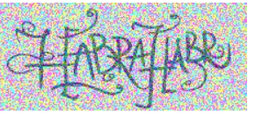
As a demonstration of the algorithm's operation, the problem of highlighting the boundaries in the following image will be solved.

Slide 10

Conversion to shades of gray
The original image is represented in the RGB model (Red, Green, Blue).
The YUV model is often used for image processing, where the Y component is responsible for luminance.
The conversion takes place according to the formula:

Slide 11

Gaussian filtering (smoothing)
After conversion to grayscale, the image may contain noise.
Gaussian blur is used to reduce it.
The core of the Gauss filter is formed by the formula:
After the transformation and smoothing, contour extraction algorithms, such as the Sobel operator, can be used for further analysis.

Slide 12
Conclusion
The Sobel method is simple and fast, suitable for basic boundary detection, but less accurate and sensitive to noise.
The Canny method is more complex and computationally expensive, but it provides accurate boundary selection by pre-smoothing, suppression of non-maxima, and double threshold processing.

Slide 13
Например, предположим, что алгоритм машинного зрения обучен обнаруживать знаки остановки на фотографиях. Если система делает снимок улицы с несколькими домами по обе стороны, она будет искать только наличие знака остановки.
система компьютерного зрения может анализировать изображение улицы с несколькими домами по обе стороны. Затем она может сканировать и идентифицировать дома, улицу и различные дорожные знаки, затем анализировать эти данные и делать вывод, что изображение представляет собой жилую улицу.
Машинное зрение работает по заранее заданным правилам и используется для автоматизированных задач, например, контроля качества на производстве. Компьютерное зрение использует машинное обучение и искусственный интеллект, чтобы «учиться» распознавать объекты и делать выводы, например, классифицировать изображения.

